Slide 1
FINAL PROJECT

Slide 2
AGENDA
Idea of the Website
What I did in the end
Difficulties during the execution

Slide 3
IDEA OF THE WEBSITE

Slide 4
why I chose it
Main reasons:
Covers front-end basics: HTML (structure), CSS (design) and JavaScript (behavior)
Is a scalable project: can start small and expand (therefore learning in a gradual way)
Portfolio value: is a professional-looking project

Slide 5
What was the idea
My first idea:
A photography website inspired by modern portfolio designs. It has a fixed vertical menu on the left and three main pages:
Gallery – photos displayed in a grid, with hover effects and an enlarged view when clicked.
About – information about a fictional photographer.
Contact – a simple form to send messages.

Slide 6
What I did

Slide 7
What I did
In the end, I did:
A photography website inspired by modern portfolio designs. It has a fixed vertical menu on the left and four main pages:
Home – A main photo that changes every 5 seconds, a small introductory text, a button that goes to contact.
Gallery – photos displayed in a grid, with hover effects and an enlarged view when clicked.
About – information about a fictional photographer.
Contact – a simple form to send messages.

Slide 8
Choosing colors and fonts

Slide 9
Choosing colors and fonts
Colors
Fonts:
I choose the colors: black, white and beige/gray.
Elegance
Simple
Sofisticated
I choose 2 fonts:
Tangerine: more design & elegant
For the titles and for the “logo”
Cormorant Garamond: simple & easy to read
For the menu and content

Slide 10

What I learned

Slide 11
why I learned
My learning process:
With the creation of this website, I was able to understand a little bit more about:
CSS Flexbox
LightBox
Formular Page via JavaScript
Change the main photo every 5 seconds (index page) via JavaScript
Gallery Page via JavaScript

Slide 12
Navigating Q&A Sessions
Preparing for questions
Maintaining composure
Know your material in advance
Anticipate common questions
Rehearse your responses
Maintaining composure during the Q&A session is essential for projecting confidence and authority. Consider the following tips for staying composed:
Stay calm
Actively listen
Pause and reflect
Maintain eye contact

Slide 13
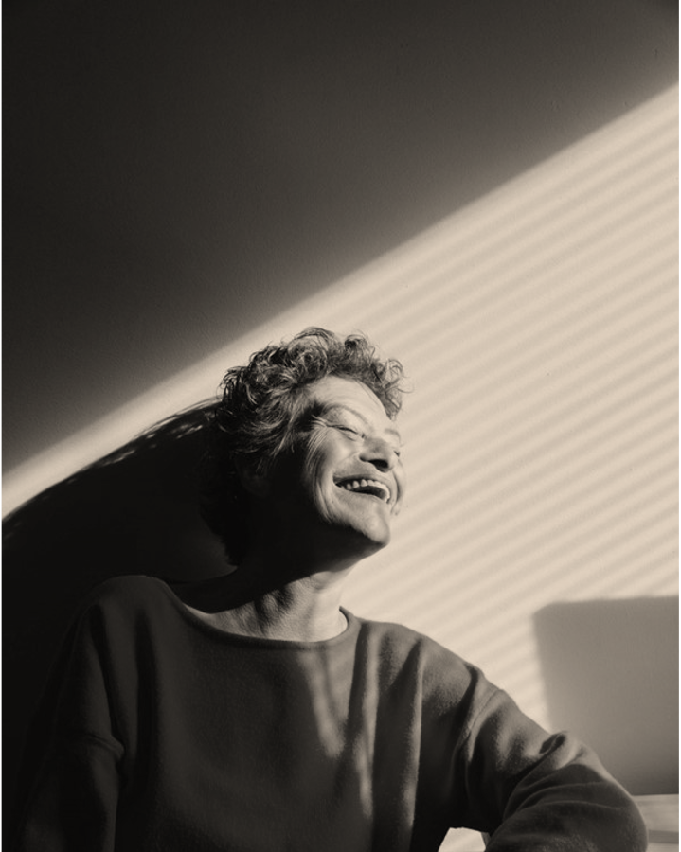
Speaking Impact
Your ability to communicate effectively will leave a lasting impact on your audience
Effectively communicating involves not only delivering a message but also resonating with the experiences, values, and emotions of those listening

Slide 14
Dynamic delivery
METRIC | MEASUREMENT | TARGET | ACTUAL
Audience attendance | # of attendees | 150 | 120
Engagement duration | Minutes | 60 | 75
Q&A interaction | # of questions | 10 | 15
Positive feedback | Percentage (%) | 90 | 95
Rate of information retention | Percentage (%) | 80 | 85
Learn to infuse energy into your delivery to leave a lasting impression
One of the goals of effective communication is to motivate your audience

Slide 15
Final tips & takeaways
Practice makes perfect
Continue improving
Consistent rehearsal
Strengthen your familiarity
Refine delivery style
Pacing, tone, and emphasis
Timing and transitions
Aim for seamless, professional delivery
Practice audience
Enlist colleagues to listen & provide feedback
Seek feedback
Reflect on performance
Explore new techniques
Set personal goals
Iterate and adapt

Slide 16
Speaking engagement metrics
IMPACT FACTOR | MEASUREMENT | TARGET | ACHIEVED
Audience interaction | Percentage (%) | 85 | 88
Knowledge retention | Percentage (%) | 75 | 80
Post-presentation surveys | Average rating | 4.2 | 4.5
Referral rate | Percentage (%) | 10 | 12
Collaboration opportunities | # of opportunities | 8 | 10

Slide 17
THANK YOU
Brita Tamm
502-555-0152
brita@firstupconsultants.com
www.firstupconsultants.com

